Slide 1

Green Pace
Security Policy Presentation
Developer: Quinlin MacKenzie
Notes:
Greetings Green Pace Team, I am Quinlin MacKenzie, and I will be going over our updated and new Security Policy. We are going to outline our overall policy as well as dive deeper into what principles are most important when considering security threats, what our coding standards and encryption policies are, as well as a deep dive into other testing and tools that will help us stay compliant and safe.

Slide 2


OVERVIEW: DEFENSE IN DEPTH
Our security policy establishes coding standards to enhance software security and reliability. It supports defense-in-depth by preventing vulnerabilities, enforcing secure coding practices, and automating security checks.
Notes:
Overall, our security policy establishes coding standards to enhance software security and reliability. It supports defense-in-depth by preventing vulnerabilities, enforcing secure coding practices, and automating security checks.

Slide 3
THREATS MATRIX
Likely SQL Injection Buffer Overflow | Priority Denial of Service (DoS) Privilege Escalation
Low priority Incorrect Data Types Minor Input Validation Issues | Unlikely Dangling Pointers Unused Resources Leaks
Notes:
The Threats Matrix categorizes security risks based on their likelihood and priority. Critical threats like SQL Injection and Buffer Overflow are both likely and high priority due to their potential for data manipulation and system compromise. Denial of Service and Privilege Escalation are unlikely but still high priority, as they could cause significant disruption or unauthorized access. Incorrect Data Types and Minor Input Validation Issues are likely but low priority, often leading to system errors rather than direct security breaches. Dangling Pointers and Unused Resource Leaks are unlikely and low priority, posing minimal security risk but requiring attention to maintain system stability.

Slide 4
10 PRINCIPLES
Validate Input Data – Ensure all user input is checked for correctness and security.
Heed Compiler Warnings – Address all compiler warnings to prevent hidden vulnerabilities.
Architect and Design for Security Policies – Implement security controls from the design phase.
Keep It Simple – Reduce complexity to minimize security risks.
Default Deny – Block all access by default and allow only explicitly permitted actions.
Adhere to the Principle of Least Privilege – Restrict user and system permissions to the minimum required.
Sanitize Data Sent to Other Systems – Clean and validate data before transmission to prevent injection attacks.
Practice Defense in Depth – Use multiple layers of security controls to mitigate threats.
Use Effective Quality Assurance Techniques – Apply rigorous testing, code reviews, and static analysis.
Adopt a Secure Coding Standard – Follow established guidelines to maintain security and consistency.
Notes:
These ten security principles form the foundation of our secure coding approach. By validating input data and sanitizing outputs, we mitigate risks like injection attacks. Compiler warnings and quality assurance techniques help identify potential vulnerabilities early. Security should be part of the design phase, with a focus on simplicity, least privilege, and defense in depth to reduce attack surfaces. The principle of default deny ensures only necessary access is granted, reinforcing secure system behavior. Lastly, following a secure coding standard helps maintain consistency and reduces security gaps across development teams.

Slide 5
CODING STANDARDS
STD-001-CPP: Type Safety
STD-002-CPP: Input Validation
STD-003-CPP: String Correctness
STD-004-CPP: SQL Injection Prevention
STD-005-CPP: Memory Protection
STD-006-CPP: Assertions
STD-007-CPP: Exceptions
STD-008-CPP: Pointer Safety
STD-009-CPP: Buffer Overflow Prevention
STD-010-CPP: Resource Cleanup
Notes:
The ranking of these coding standards is based on a combination of exploitability, impact severity, and ease of detection. Memory-related issues, such as buffer overflows (STD-009-CPP), pointer safety (STD-008-CPP), and memory protection (STD-005-CPP), are ranked highest due to their potential for remote code execution and system compromise. Input validation (STD-002-CPP) and SQL injection prevention (STD-004-CPP) also rank high as they are common attack vectors. String correctness (STD-003-CPP) follows due to encoding and buffer manipulation risks. Lower-ranked standards, like assertions (STD-006-CPP) and exceptions (STD-007-CPP), are critical for maintaining stability but have less direct security impact. Resource cleanup (STD-010-CPP) is important for preventing leaks and ensuring proper system function over time.

Slide 6
ENCRYPTION POLICIES
Encryption policies ensure data security at all stages:
In Flight: TLS 1.3 secures data during transmission.
At Rest: AES-256 encrypts stored data to prevent unauthorized access.
In Use: Memory encryption and secure enclaves protect active data.
Notes:
To protect data at all stages, we enforce encryption policies that align with industry standards. Encryption in flight utilizes TLS 1.3 to secure data traveling over networks, preventing interception and tampering. Encryption at rest ensures stored data remains protected using AES-256, guarding against unauthorized access even if physical storage is compromised. Encryption in use is implemented through memory encryption and secure enclaves, reducing exposure to attacks targeting active data. Together, these measures provide a layered defense against unauthorized access and data breaches.

Slide 7
TRIPLE-A POLICIES
Security policies enforce:
Authentication: Multi-factor authentication (MFA) and strong password policies.
Authorization: Role-based access control (RBAC) and least privilege enforcement.
Accounting: Audit logs and real-time monitoring for accountability.
Notes:
Our security policies ensure robust authentication, authorization, and accounting (AAA) to protect systems and data. Authentication requires strong passwords and multi-factor authentication (MFA) to verify user identities. Authorization follows the principle of least privilege, using role-based access control (RBAC) to limit access to only what is necessary. Accounting is maintained through audit logs and real-time monitoring, tracking all user activities to detect and respond to security incidents effectively. Together, these policies establish a comprehensive security framework for access control and compliance.

Slide 8
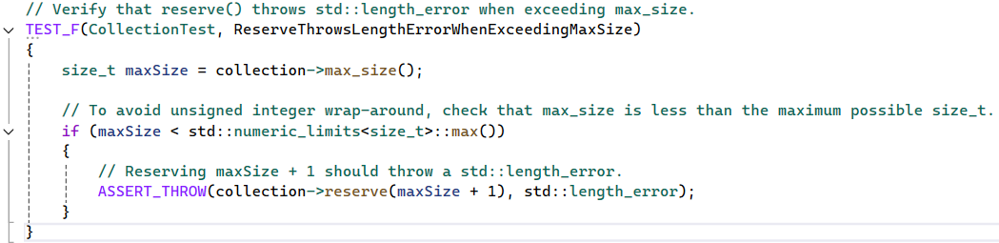
Unit Testing: Test Design
Notes:
Unit tests are essential for ensuring that edge cases in our code do not cause unexpected behavior. In this test, we focus on testing the reserve() method of std::vector to ensure it behaves correctly when attempting to reserve more capacity than the vector’s max_size(). This kind of test is important to prevent exceeding system limits and ensuring that the application behaves gracefully when memory boundaries are hit. This code shows the ReserveThrowsLengthErrorWhenExceedingMaxSize test case. The test first retrieves the max_size() of the vector, which is the maximum number of elements that can be stored in the vector without causing overflow. Next, we check to ensure that max_size() is not equal to the maximum possible value of size_t, which could cause issues due to unsigned integer wrap-around. The test then attempts to call reserve() with a value that exceeds max_size() by 1. We expect this action to throw a std::length_error exception, so we use the ASSERT_THROW macro to validate that this exception is indeed thrown when the reserve() call is made.

Slide 9
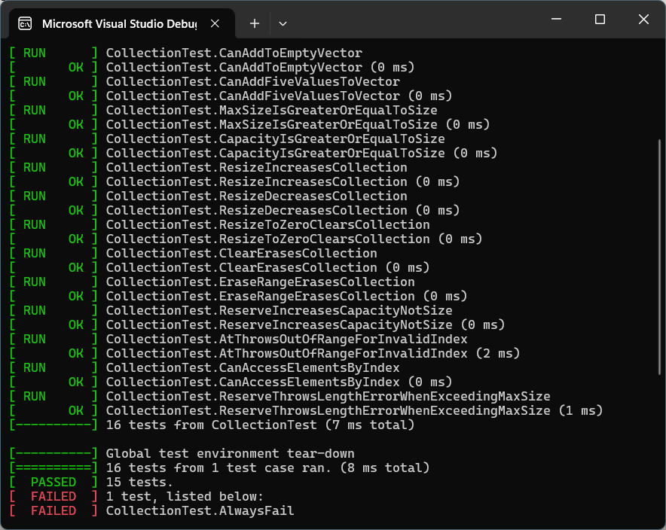
Unit Testing: Results
Notes:
This image shows the result of running the test. In the case of a successful test, we see the test marked as passed, confirming that reserving beyond max_size() correctly throws a std::length_error. If the test failed, the Google Test Runner would indicate a failure, such as with our Fail-always test in this series, prompting further investigation to ensure that the std::length_error exception was properly thrown in the test. Unit testing in general is an important skill to develop, and series of tests such as can be seen here need to be implemented to make sure that errors are planned for and caught before becoming a larger, more expensive, and dangerous issue.

Slide 10

AUTOMATION SUMMARY
Notes:
The DevSecOps automation flow is represented by a figure-eight or infinity symbol, illustrating the continuous cycle of development. This process starts with Assessing and Planning, where tools are used to identify potential security risks. As development progresses to Designing and Building, tools like SonarQube and Cppcheck scan code for vulnerabilities. During the Maintaining System Integrity phase, tools like OWASP ZAP and Clang Static Analyzer perform dynamic and static analysis. Throughout the cycle, continuous integration and testing ensure security policies are enforced, and ongoing adjustments improve security in every phase of the development lifecycle.

Slide 11
TOOLS
DevSecOps Pipeline: Integration of security at every stage of the CI/CD pipeline.
External Tools: Used for code scanning, testing, and monitoring at various stages of development.
Notes:
The DevSecOps pipeline integrates security throughout the CI/CD process, ensuring security checks are continuously applied as code is developed, tested, and deployed. External tools, such as static analysis tools (e.g., SonarQube, Cppcheck) run early to catch vulnerabilities, while vulnerability scanners (e.g., OWASP ZAP) operate during testing to identify security issues before deployment. Monitoring tools are employed post-deployment to detect real-time threats, ensuring ongoing security assurance. This approach embeds security into the development workflow, making it an integral part of the process.

Slide 12
RISKS AND BENEFITS
Problems: Security vulnerabilities in the development lifecycle can lead to breaches and compliance issues.
Solutions: Implementing DevSecOps and integrating security throughout the CI/CD pipeline.
Act Now vs. Wait: Acting now reduces risks and costs, while waiting could increase system vulnerabilities and costs.
Strategy Gaps: Early-stage security integration and post-deployment monitoring.
Risks of the Strategy: Potential delays, resource allocation challenges, and over-reliance on automation.
Steps to Take: Early security integration, continuous monitoring, and team training.
Notes:
There are several key challenges when it comes to ensuring the security of systems throughout their development lifecycle. Without proper security measures, vulnerabilities can be introduced at any stage—during design, coding, or deployment. These issues can lead to data breaches, legal consequences, and significant costs if not addressed proactively. The solution to this problem lies in implementing a DevSecOps strategy, where security is embedded into every phase of development. This involves integrating security checks into the CI/CD pipeline, using tools like static analysis and vulnerability scanners that continuously monitor for vulnerabilities. This proactive approach allows teams to address security issues as soon as they arise, rather than waiting for post-deployment testing. When it comes to timing, acting now has clear benefits. By integrating security early and continuously, you reduce the risk of costly breaches and vulnerabilities being discovered after deployment. On the other hand, delaying the integration of security practices could result in greater risks, such as system vulnerabilities going undetected or increasing costs for remediation later on. However, there are still gaps in many security strategies. The integration of security during the planning phase is often overlooked, and post-deployment monitoring can be inadequate. Without these aspects, there’s a risk of new threats emerging after the system is live. There are also some potential risks with this strategy. Resource allocation may be challenging, and security testing could delay the overall development timeline. In addition, relying too heavily on automated security tools without human oversight can lead to missed vulnerabilities. To address these gaps, it’s essential to integrate security early in the development process, ensure continuous post-deployment monitoring, and invest in training teams to use security tools effectively. Taking these steps will help mitigate risks and improve system security.

Slide 13
RECOMMENDATIONS
Gaps Identified: Insufficient security during planning, lack of real-time monitoring, and inadequate employee training.
Actions to Address Gaps: Integrate security from the planning phase, enhance monitoring after deployment, and improve security training for teams.
Future Focus: Continuous evaluation and updates to the security policy to stay ahead of evolving threats.
Key Recommendations: Strengthen early-stage security, ensure comprehensive monitoring, and train teams on security best practices.
Notes:
As we evaluate the current security policy, several gaps have become evident. One of the key areas lacking attention is the planning phase, where security integration is often an afterthought rather than a foundational consideration. Additionally, there is a lack of comprehensive monitoring post-deployment, which is essential for identifying new and emerging threats. Another significant gap is the insufficient security training for development teams, which can lead to poor security practices and missed vulnerabilities. To address these gaps, I recommend a few strategic actions. First, integrating security from the beginning of the development process—during planning and design—will create a stronger foundation for secure code. By embedding security into every phase, teams can anticipate and mitigate potential vulnerabilities early on. Secondly, there needs to be enhanced monitoring once the system is deployed. Real-time monitoring and logging can provide valuable insights into system activity and alert teams to security threats before they escalate. Finally, training and educating the development teams on security best practices is critical. This will not only improve the quality of the code produced but also foster a culture of security within the organization. Looking ahead, it’s important to continuously evaluate and update the security policy. Cyber threats evolve quickly, and staying ahead of potential risks means ensuring that our policies remain up to date with emerging threats and industry standards. By addressing these gaps now, we can build a more resilient and secure system for the future.

Slide 14
CONCLUSIONS
Adopted Standards: Emphasize encryption, secure coding practices, and continuous monitoring.
Key Focus Areas: Implement secure coding guidelines such as buffer overflow prevention and SQL injection prevention.
Future Direction: Regular updates and adaptations to standards to keep pace with emerging threats.
Notes:
To prevent future problems and strengthen the security of our systems, it is essential to adopt a set of core standards that will provide robust protection throughout the development lifecycle. First, encryption should be universally applied, especially for data in transit and at rest, ensuring that sensitive information remains protected at all stages. Implementing strong secure coding practices is also critical—focusing on standards like buffer overflow prevention and SQL injection prevention will help mitigate common vulnerabilities in our code. Another priority is the ongoing monitoring of our systems after deployment. Continuous monitoring tools, such as vulnerability scanners and real-time threat detection, should be integrated into the DevSecOps pipeline to proactively address security risks as they arise. Looking forward, we must remain vigilant and adaptable. The cybersecurity landscape is constantly changing, so our standards must evolve to stay ahead of emerging threats. Regular reviews and updates to security policies will help us ensure that we’re always operating with the most up-to-date and comprehensive standards available. By adopting these standards now, we are not only securing our systems today but also positioning ourselves to address future challenges in a rapidly evolving digital environment.

Slide 15
REFERENCES
Schneider, F. B. (2004). Secure coding in C and C++. Addison-Wesley Professional.
Seacord, R. C. (2005). SEI CERT C++ coding standard. Addison-Wesley Professional.

